Slide 1
Smart India Hackathon 2017
Ministry Category : Indian Space Research Organisation (ISRO)
Problem Statement : Secure distribution of restricted documents outside the organization
Team Leader Name : Anup Kumar Panwar
Problem Code : #ISR42
Current AICTE Application No. : 1-3328528908
IDEA
Our idea is to develop a PC Software with following features :-
The creator of the confidential document will upload it on the software and it will automatically encrypt it.
This document can then be opened only through our software .
The software will require login and only those users can access the document who have got a permission from the creator.
Selecting, Copying, Downloading and Taking Screenshots will be disabled in the Software.
Only the creator of the file can share it.
And solution for Problem 2 is that we will access the users webcam.
The app will close automatically if there is any illegal activity detected through webcam using image processing and an photo taken through web cam will be sent to server for taking strict action again the culprit.
Moreover, it will also send the logs to server of each user and their activities like when and which document are they reading.
There will be centralized dashboard which will trace the flow of every document.
Technology Stack
PHP, MySQL DB, Python, AJAX, APACHE server, WAMP/LAMP, JavaScript, OpenCV, scikit-image, PyPDF2, PyQT, PyCrypto

Slide 2
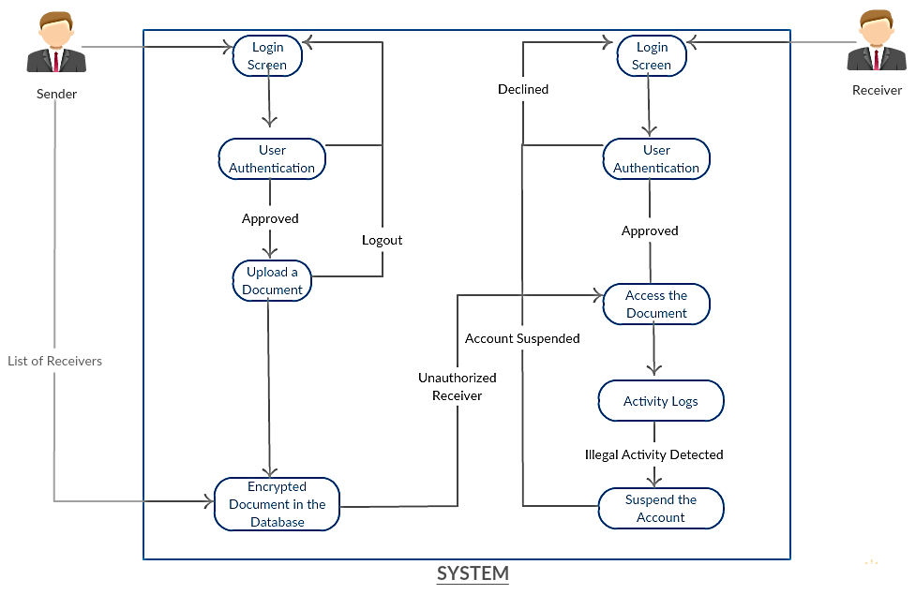
USE CASE
DEPENDENCIES
Internet Connection, A computer, Webcam, PyQT, PyPDF2, Linux /Windows 10

Slide 3
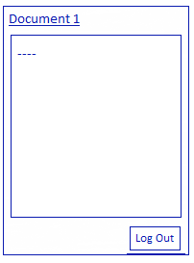
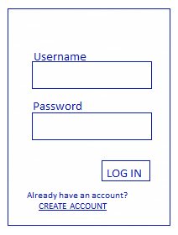
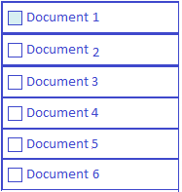


WIREFRAMES
My Files
Received Files
Hello World!
This is Highly Confidential Doc. And it can be accessed only through this Software
(NOTE : Selecting, copying, taking screenshot is disabled)
LOG OUT
Login
User’s Vault
Sample Document
User | Document | Time
MS Kapila | The MARS Mission.pdf | 4th Feb 2017 12:25:47
Kunal Joshi | ISRO Inside.pdf | 4th Feb 2017 13:46:25
Activity Logs

Slide 4
Tracking A Document
Director
Nikhil
[3rd Feb 2017]
Bhavya
[3rd Feb 2017]
Mansi
[5th Feb 2017]
Anup
[4th Feb 2017]
Riya
[5th Feb 2017]
Mahima
[4th Feb 2017]
DOCUMENT 1
If someone’s account is compromised then he can check if any undesirable document sharing has occurred or not

Slide 5
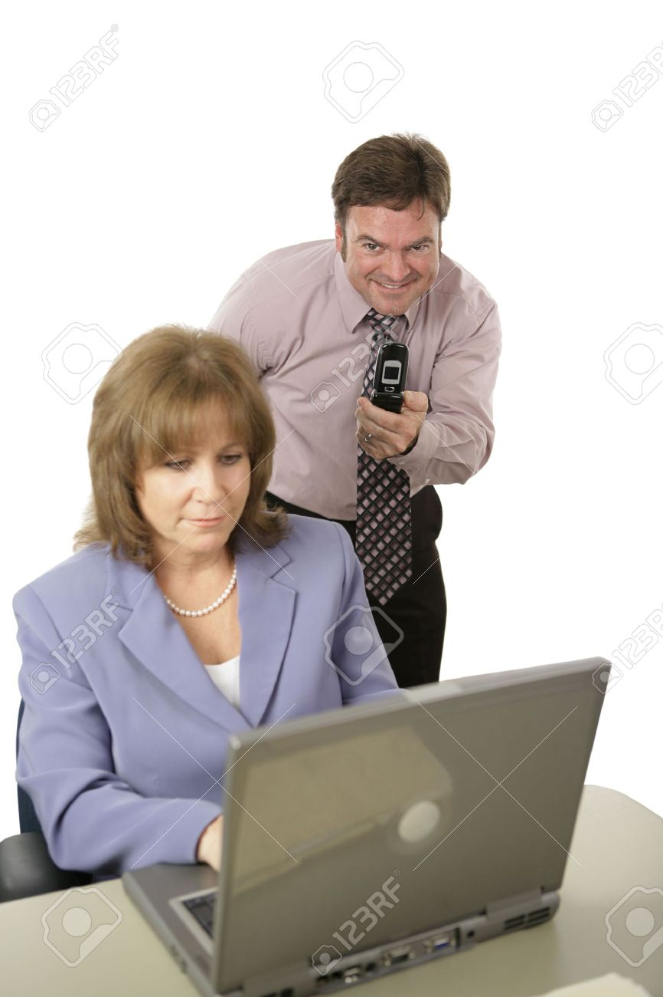

The Webcam is always active and checks for illegal Activities
“Illegal Photography detected”
Account Suspended!
Coming Soon…

